Slide 1





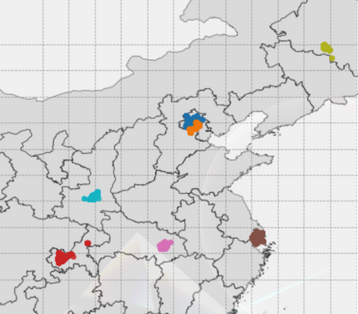
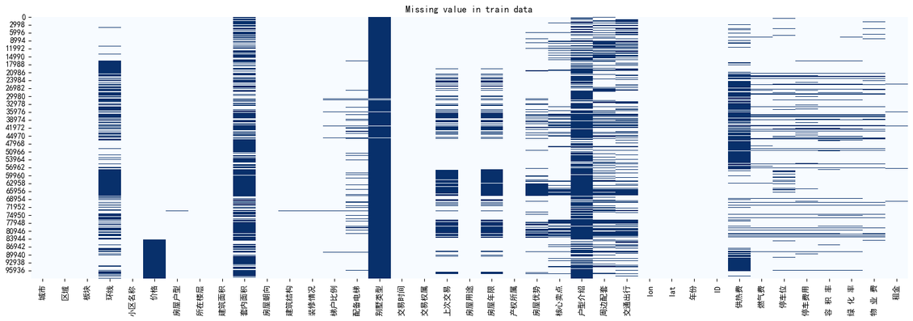

房产价格线性建模预测
Fintech
段毅
2025年4月3日
数据分析
In-depth analysis and future prospects of the AI ​​industry
one hot encoding
Data digging
Data digging
Label
encoding
Data digging
Data digging
one hot encoding
one hot encoding
Data digging
one hot encoding
one hot encoding
one hot encoding
Data digging
one hot encoding
one hot encoding
Data digging
Data digging
Data Wrangler

Slide 2
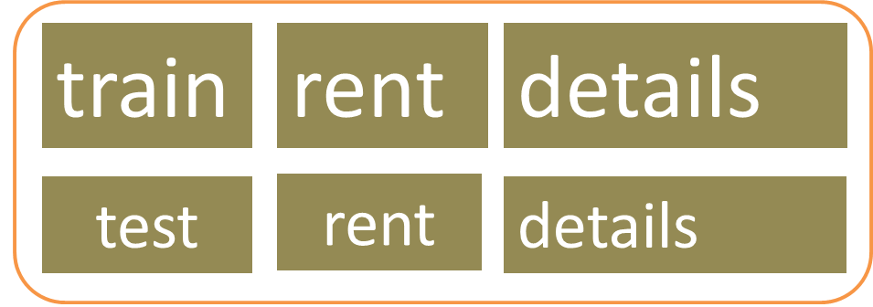
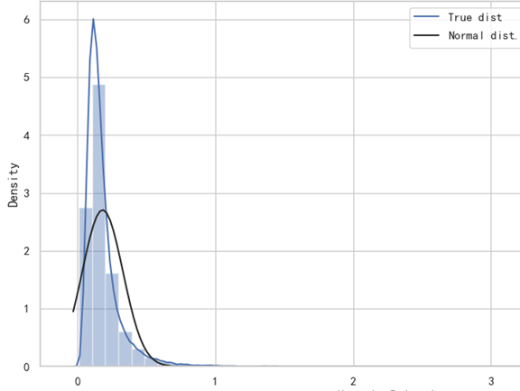
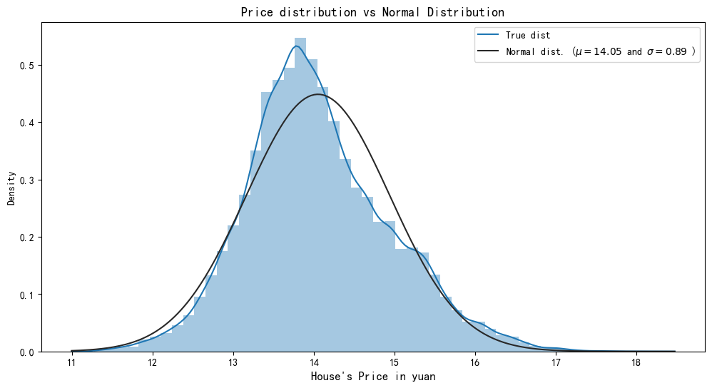
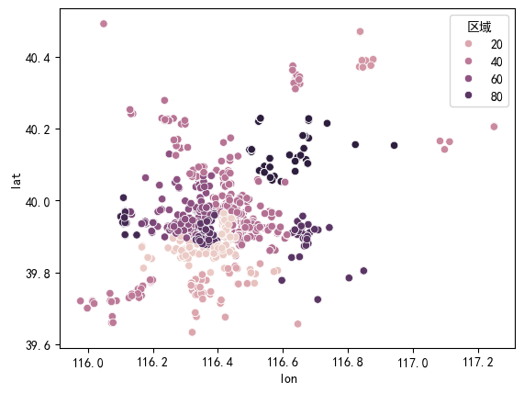
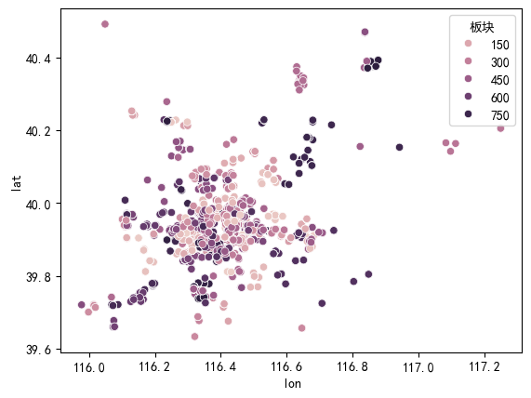
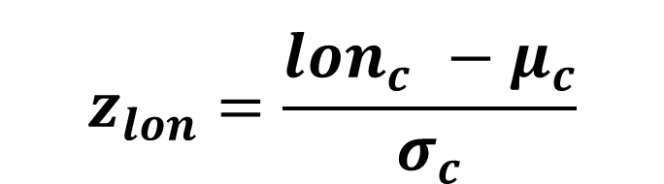
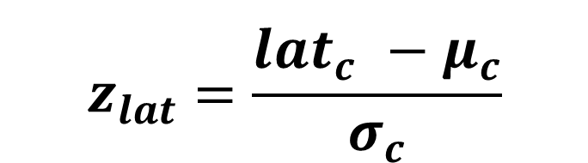

数据处理
04 对价格做log变换
01 合并化处理：
价格存在长尾分布，因此使用log函数对价格进行变换，将长尾分布的尾部拉长，使数据更接近正态分布。
02 经纬度按城市Z-score变换
$$z_{lat}=\frac{{lat}_{c}^{}−μ_{c}}{σ_{c}}$$
df['lat2central'] = df.groupby('城市')['lat'].transform(lambda x: (x - x.mean())**2/ x.std())
df['lon2central'] = df.groupby('城市')['lon'].transform(lambda x: (x - x.mean())**2/ x.std())
df.drop(['lat','lon'],axis=1,inplace=True)
$$z_{lon}=\frac{{lon}_{c}^{}−μ_{c}}{σ_{c}}$$
05 线性label-encode
floor_mapping = {
'低楼层': 1,
'中楼层': 2,
'高楼层': 3,
'顶层': 4,
'底层': 0,
'地下室': -1
}
def process_floor(floor_str):
# 提取楼层位置
floor_position = re.search(r'(低楼层|中楼层|高楼层|顶层|底层|地下室)', floor_str)
position_value = floor_mapping[floor_position.group()] if floor_position else None
# 提取总楼层数
total_floors = re.search(r'共(\d+)层', floor_str)
total_floors_value = int(total_floors.group(1)) if total_floors else None
return position_value, total_floors_value
# 应用到数据框
df[['楼层位置encode', '总楼层数']] = df['所在楼层'].apply(lambda x: pd.Series(process_floor(x)))
df,_ = class2onehot(df,'楼层位置encode')
df = df.drop(['所在楼层'], axis=1)
# 室、厅、厨、卫、房间
df['室'] = df['房屋户型'].apply(lambda x:int(x.split('室')[0]) if '室' in str(x) else 0)
df['厅'] = df['房屋户型'].apply(lambda x:int(x.split('厅')[0].split('室')[-1]) if '厅' in str(x) else 0)
df['厨'] = df['房屋户型'].apply(lambda x:int(x.split('厨')[0].split('厅')[-1]) if '厨' in str(x) else 0)
def process1(x):
if '卫' in str(x):
if '厨' in str(x):return int(x.split('卫')[0].split('厨')[-1])
else: return int(x.split('卫')[0].split('房间')[-1])
else:return 0
def process2(x):
if '房间' in str(x):
if '卫' in str(xreturn int(x.split('房间')[0])
else:return 0
df['卫'] = df['房屋户型'].apply(process1)
df['房间'] = df['房屋户型'].apply(lambda x:int(x.split('房间')[0]) if '房间' in str(x) else 0)
df['室'] = df['室'] + df['房间']
df = df.drop(['房间'], axis=1)
df = df.drop('房屋户型',axis=1)
line2num_dict = {
'二至三环': 2, '五至六环': 5,
'三至四环': 3,'四至五环': 4,
'六环外': 6, '二环内': 2,
'内环内': 1, '内环至外环': 0,
'外环外': 7, '中环至外环': 8,
'内环至中环': 9, '一至二环': 1,
'一环内': 0, '四环外': 4, '三环外': 3
}
df['环线'] = df['环线'].map(line2num_dict)
df['lift_ratio'] = df['梯户比例'].apply(lambda x:
chinese2num_dict[x.split('梯')[0]]/chinese2num_dict[x.split('梯')[1].replace('户','')]
if '梯' in str(x) else 0)
df = df.drop('梯户比例',axis=1)
df,_ = class2onehot(df,'配备电梯')
df['lift_ratio'] = df['lift_ratio']*(1-df['配备电梯_无'])
df = df.drop(['配备电梯_无'],axis=1)
03 自然语言向量化：TF-IDF
tfidf_vectorizers = {column: TfidfVectorizer(max_features=100, tokenizer=chinese_tokenizer)}
# 进行TF-IDF编码
df[column] = df[column].fillna('')
tfidf_matrix_train = tfidf_vectorizers[column].fit_transform(df[column])
$$TF_{ij}=\frac{N_{ij}}{\sum_{k=1}^{K}{N_{ik}}}$$

Slide 3
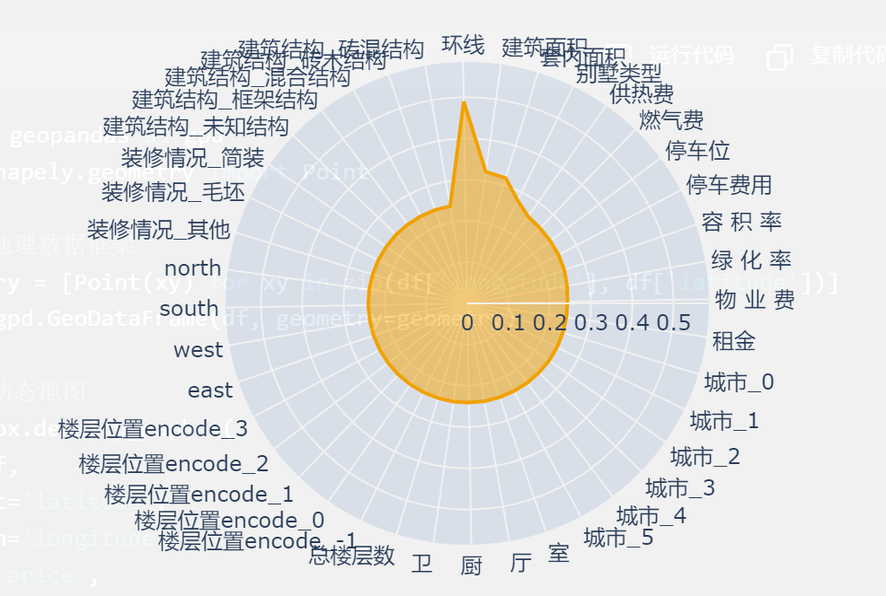
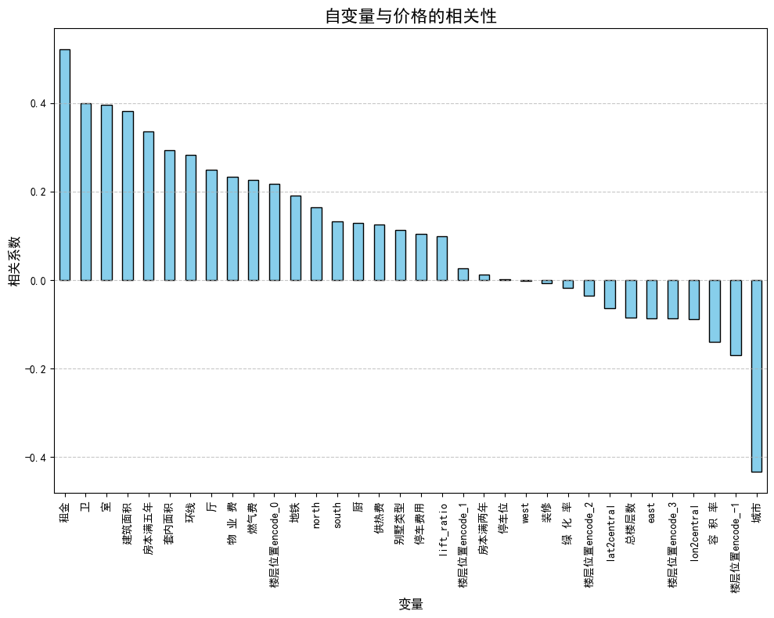
建模结果
比较所有用于建模的自变量与价格的相关性和对预测的贡献度
适当删去一些自变量以降低数据矩阵的稀疏性
最终结果
Model | In-sample MAE | In-sample RMSE | Out-of-sample MAE | Out-of-sample RMSE | Cross-validation MAE | Cross-validation RMSE | Datahub Score
OLS | 0.239437 | 0.310717 | 0.243293 | 0.319328 | 0.395277 | 0.628711 | 57.149
LASSO | 0.437444 | 0.587682 | 0.44438 | 0.620972 | 0.577612 | 0.760008 | 45.279
Ridge | 0.239479 | 0.310735 | 0.243294 | 0.319314 | 0.394773 | 0.628309 | 57.172
ElasticNet | 0.41061 | 0.552845 | 0.416441 | 0.583364 | 0.56572 | 0.752144 | 53.423

